Slide 1
Java String

Slide 2
String is a sequence of characters. But in Java, string is an object that represents a sequence of characters. The java.lang.String class is used to create a string object.

Slide 3
Java String class provides a lot of methods to perform operations on string such as compare(), concat(), equals(), split(), length(), replace(), compareTo(), intern(), substring() etc.

Slide 4
How to create a string object?
There are two ways to create String object:
1. By string literal
2. By new keyword
1) String Literal
Java String literal is created by using double quotes. For Example:
String s="welcome";
Each time you create a string literal, the JVM checks the "string constant pool" first. If the string already exists in the pool, a reference to the pooled instance is returned. If the string doesn't exist in the pool, a new string instance is created and placed in the pool. For example:
String s1="Welcome";
String s2="Welcome";//It doesn't create a new instance

Slide 5
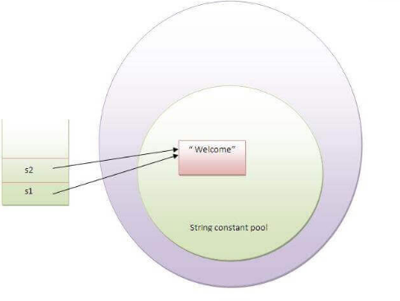

Slide 6
In the above example, only one object will be created. Firstly, JVM will not find any string object with the value "Welcome" in string constant pool, that is why it will create a new object. After that it will find the string with the value "Welcome" in the pool, it will not create a new object but will return the reference to the same instance.

Slide 7
Note:
String objects are stored in a special memory area known as the "string constant pool".
Why Java uses the concept of String literal?
To make Java more memory efficient (because no new objects are created if it exists already in the string constant pool).

Slide 8
2) By new keyword
String s=new String("Welcome");//creates two
objects and one reference variable
In such case, JVM will create a new string object in normal (non-pool) heap memory, and the literal "Welcome" will be placed in the string constant pool. The variable s will refer to the object in a heap (non-pool).

Slide 9
public class StringExample{
public static void main(String args[]){
String s1="java";//creating string by java string literal
char ch[]={'s','t','r','i','n','g','s'};
String s2=new String(ch);//converting char array to string
String s3=new String("example");//creating java string by new keyword
System.out.println(s1);
System.out.println(s2);
System.out.println(s3);
}}

Slide 10
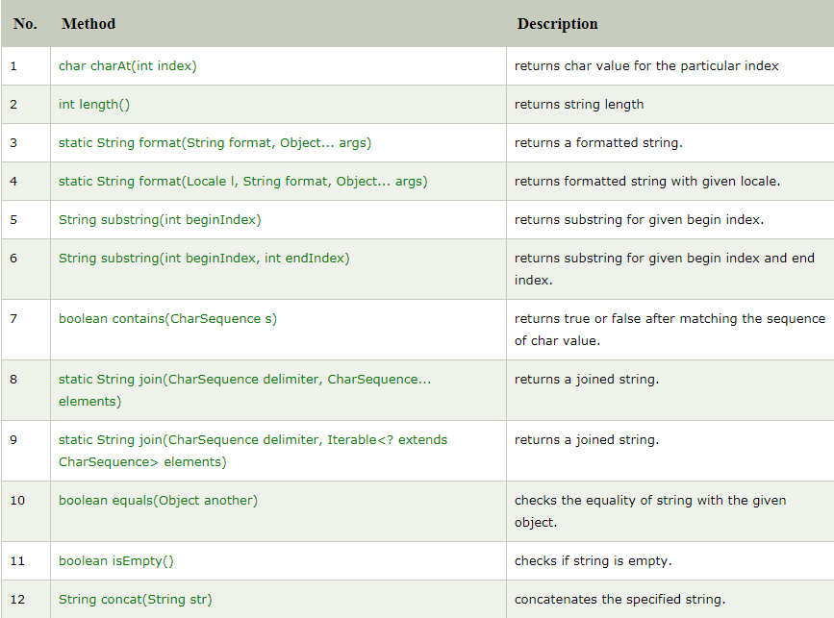
String Methods

Slide 11
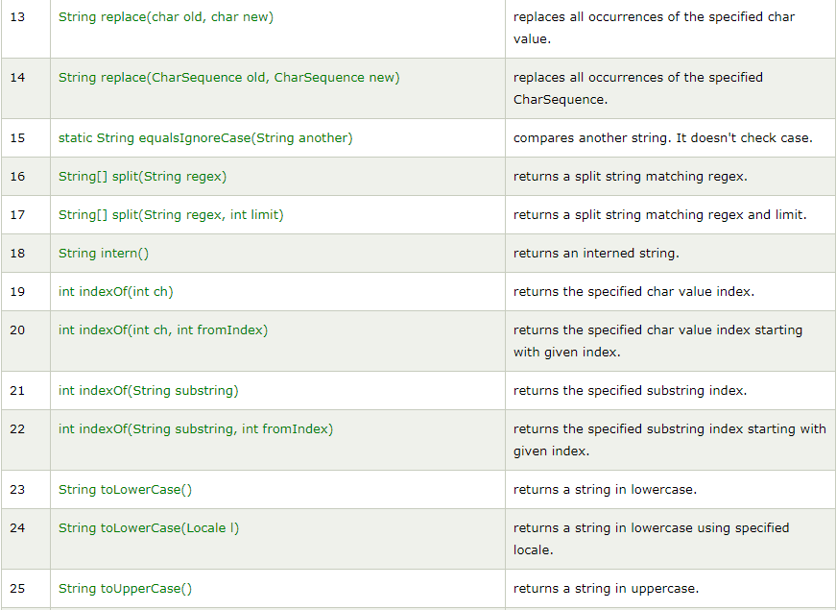

Slide 12
Immutable String in Java
In java, string objects are immutable. Immutable simply means unmodifiable or unchangeable.
Once string object is created its data or state can't be changed but a new string object is created.
class st2{
public static void main(String args[]){
String s="Sachin";
s.concat(" Tendulkar");
System.out.println(s); } }

Slide 13
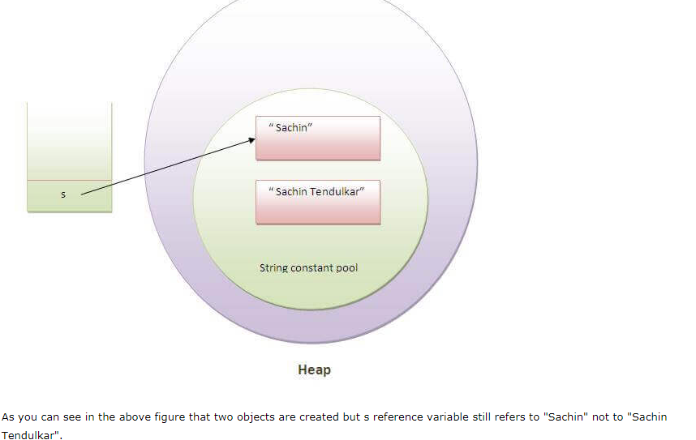

Slide 14
But if we explicitely assign it to the reference variable, it will refer to "Sachin Tendulkar" object.For example:
class Testimmutablestring1{
public static void main(String args[]){
String s="Sachin";
s=s.concat(" Tendulkar");
System.out.println(s);
}
}
Note: In such case, s points to the "Sachin Tendulkar". Please notice that still sachin object is not modified.

Slide 15
Why string objects are immutable in java?
Because java uses the concept of string literal.Suppose there are 5 reference variables,all referes to one object "sachin".If one reference variable changes the value of the object, it will be affected to all the reference variables. That is why string objects are immutable in java.

Slide 16
Java String compare
We can compare string in java on the basis of content and reference.
It is used in authentication (by equals() method), sorting (by compareTo() method), reference matching (by == operator) etc.
There are three ways to compare string in java:
By equals() method
By = = operator
By compareTo() method

Slide 17
1) String compare by equals() method
The String equals() method compares the original content of the string. It compares values of string for equality. String class provides two methods:
public boolean equals(Object another) compares this string to the specified object.
public boolean equalsIgnoreCase(String another) compares this String to another string, ignoring case.

Slide 18
Example 1:
String s1="Sachin";
String s2="Sachin";
String s3=new String("Sachin");
String s4="Saurav";
System.out.println(s1.equals(s2));
System.out.println(s1.equals(s3));
System.out.println(s1.equals(s4));
Example 2
String s1="Sachin";
String s2="SACHIN";
System.out.println(s1.equals(s2));
System.out.println(s1.equalsIgnoreCase(s2));

Slide 19
2) String compare by == operator
The = = operator compares references not values.
Example 3
String s1="Sachin";
String s2="Sachin";
String s3=new String("Sachin");
System.out.println(s1==s2);
System.out.println(s1==s3);

Slide 20
3) String compare by compareTo() method
The String compareTo() method compares values lexicographically and returns an integer value that describes if first string is less than, equal to or greater than second string.
It compares strings on the basis of Unicode value of each character in the strings.
Suppose s1 and s2 are two string variables. If:
s1 == s2 :0
s1 > s2 :positive value
s1 < s2 :negative value

Slide 21
Example 4
String s1="Sachin";
String s2="Sachin";
String s3="Ratan";
System.out.println(s1.compareTo(s2));//0
System.out.println(s1.compareTo(s3));//1(because s1>s3)
System.out.println(s3.compareTo(s1));//-1(because s3 < s1 )

Slide 22
Example 5
String s1="hello";
String s2="hello";
String s3="meklo";
String s4="hemlo";
String s5="flag";
System.out.println(s1.compareTo(s2));
System.out.println(s1.compareTo(s3)); System.out.println(s1.compareTo(s4)); System.out.println(s1.compareTo(s5));

Slide 23
Java String compareTo(): empty string
If you compare string with blank or empty string, it returns length of the string. If second string is empty, result would be positive. If first string is empty, result would be negative.
String s1="hello";
String s2="";
String s3="me";
System.out.println(s1.compareTo(s2));
System.out.println(s2.compareTo(s3));

